Slide 1
Assembly Language Programming Techniques

Slide 2
Programming Techniques
Looping
Counting
Indexing

Slide 3
Looping
The program is instructed to execute certain set of instructions repeatedly to execute a particular task number of times.
Counting
This technique allows programmer to count how many times the instruction/set of instructions are executed.
Indexing
This technique allows programmer to point or refer the data stored in sequential memory location one by one.

Slide 4
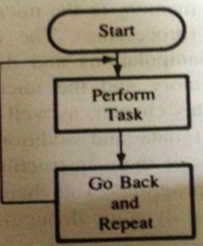
Loop
Continuous loop
repeat task continuously
Conditional loop
repeats a task until certain data conditions are met

Slide 5
Loop
Loops have four sections:
Initialization section.
Processing section.
Loop control section
Result section.

Slide 6
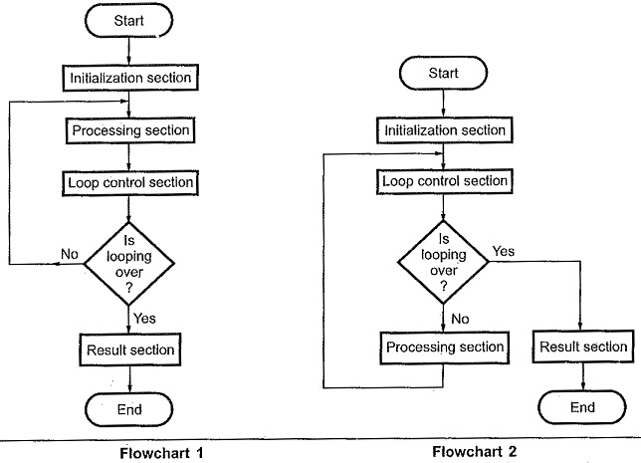

Slide 7
The initialization section establishes the starting values of
loop counters for counting how many times loop is executed
address registers for indexing which give pointers to memory locations and other variables
The actual data manipulation occurs in the processing section.
The loop control section updates counters, indices (pointers) for the next iteration.
The result section analyzes and stores the results.

Slide 8
Conditional Loop and Counter
A counter is a typical application of the conditional loop.
A microprocessor needs a counter to accomplish the looping task.
Counter is set up by loading an appropriate count in a register.
Counting is performed by either increment or decrement the counter.
Loop is set up by a conditional jump instruction.
End of counting is indicated by a flag

Slide 9
Indexing
Pointing of referencing objects with sequential numbers.
Data bytes are stored in memory locations and those data bytes are referred to by their memory locations.
Example: add ten bytes of data stored in memory locations starting from a given location and display the sum.

Slide 10
To find the sum of a series of 8 bit numbers
The length of the series is in memory location 2200H and the series begins at memory location 2201H. Assume sum is 8bit. Store the result in 2300H
2200H=04H
2201H=20H
2202H=15H
2203H=13H
2204H=22H
Result=20+15+13+22=6AH
2300H=6AH

Slide 11
Start
Sum=0
Pointer=2201 H
Count=2200 H
Sum=Sum + (Pointer)
Pointer=Pointer + 1
Count = Count -1
Is Count = 0
No
2300H = Sum
End

Slide 12
Source Program
LDA 2200H
MOV C,A ;Initialize counter
SUB A ;sum=0
LXI H,2201H ;Initialize pointer
BACK: ADD M ;sum=sum+data
INX H ; Increment pointer
DCR C ; decrement counter
JNZ BACK ;If counter ≠0 repeat
STA 2300H ;store sum
HLT ;Terminate program execution

Slide 13
Assume sum is 16bit
2200H=04H
2201H=9AH
2202H=52H
2203H=89H
2204H=3EH
Result=9A+52+89+3E=01B3H
2300H=B3H (lower byte of sum)
2301=01H(Higher byte of sum)

Slide 14
Start
Sumhigh=0
Sumlow=0
Pointer=2201 H
Count=2200 H
Sumlow=Sumlow + (Pointer)
No
Is Carry= 1
Sumhigh=Sumhigh + 1
Pointer=Pointer + 1
Count = Count -1
No
Is Count =0
2300H = Sumlow
End

Slide 15
Source Program
LDA 2200H
MOV C,A ;Initialize counter
LXI H,2201H ;Initialize pointer
SUB A ;sumlow=0
MOV B,A ;sumhigh=0
BACK: ADD M ;sum=sum+data
JNC SKIP
INR B ;Add carry to MSB of sum
SKIP: INX H ; Increment pointer
DCR C ; decrement counter
JNZ BACK ;If counter ≠0 repeat
STA 2300H ;store the lower byte of sum
MOV A,B
STA 2300H ;store the higher byte of sum
HLT

Slide 16
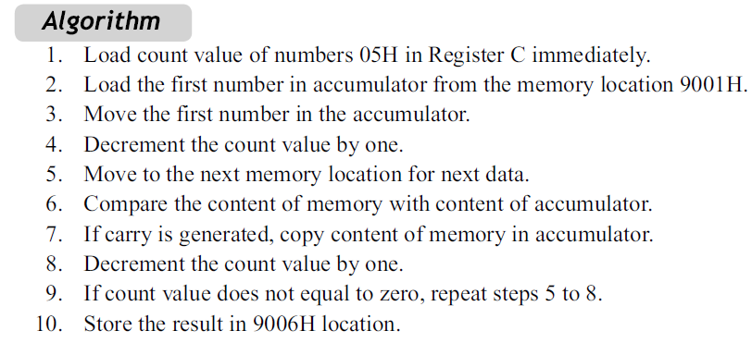
Example
Find out the largest number from an array of 5 numbers.

Slide 17
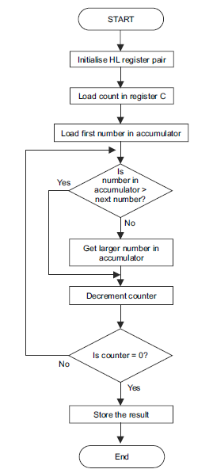

Slide 18
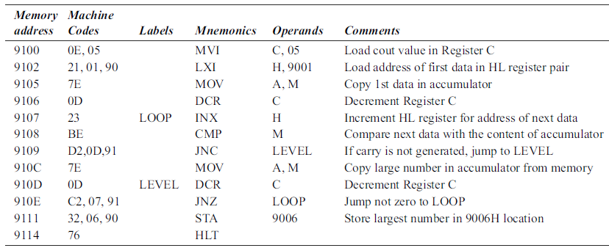

Slide 19
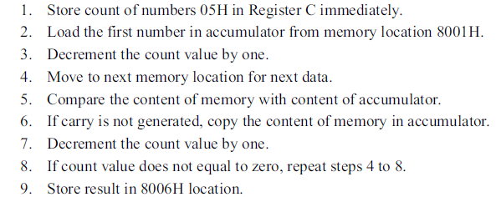
Example 2
Find out the smallest number from a series of 5 numbers.

Slide 20
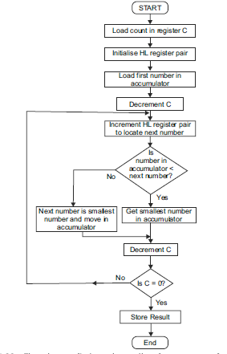

Slide 21
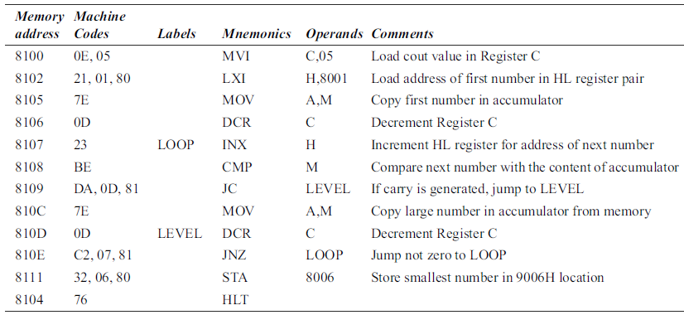

Slide 22
